Slide 1

gRPC
Beyond REST APIs
Tomáš Machala | linkedin.com/in/tomasmachala

Slide 2
What is gRPC
grpc
rest
Hi-performance RPC framework
Built around contracts
Protocol Buffers
HTTP/2
A set of simple API design principles
Contracts are optional
JSON or XML
HTTP 1.1
Notes:
Explain by comparing it with REST
REST:
Build a service
Publish a description (Swagger)
Generate contracts on the other side (AutoRest, NSwag)
gRPC:
Define the contract
Generate server
Generate client

Slide 3
Supported Platforms
Android Java C++ C# Dart Go Java
Node.js Objective-C PHP Python Ruby Web
Plus many unofficial ports
Limited browser support
Notes:
Browser support:
Most browsers support HTTP/2 (except for IE 11)
Might not work end-to-end (deep packet inspection)
Some features aren’t supported (bi-directional streaming)

Slide 4
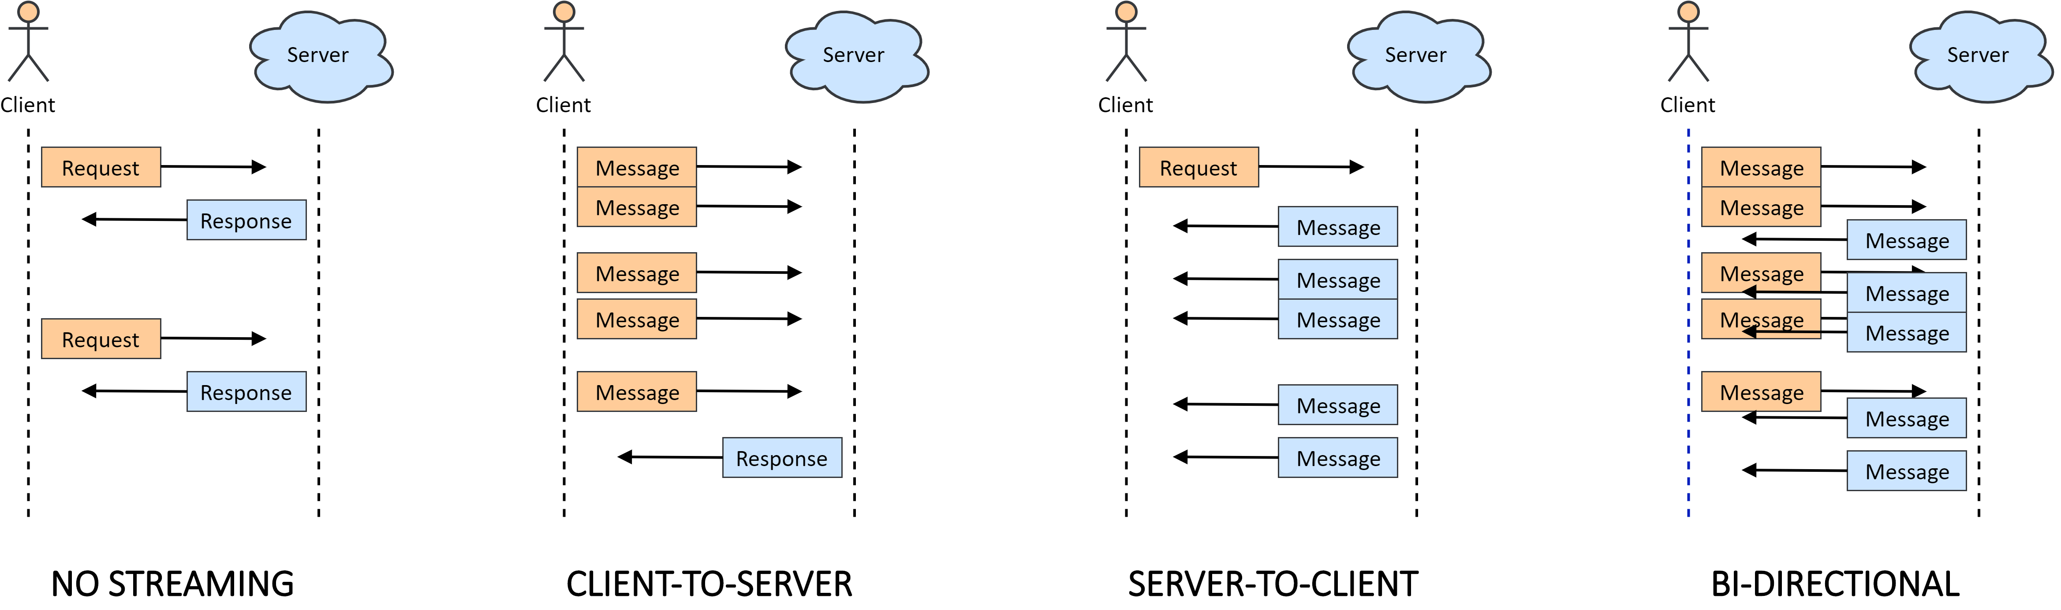
Streaming Modes
Notes:
Message streaming (as opposed to e.g. video streams)
Even in the last case, it’s still a single connection and the client can do other things simultaneously.

Slide 5
Authentication
SSL certificates
Server authentication
Optional client certificates
Metadata-based credentials:
JWT, OAuth 2 tokens, …
Credentials handling:
Per-channel
Per-call

Slide 6


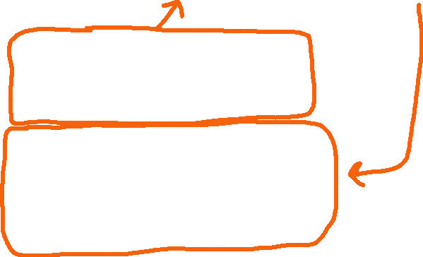




Protocol Buffers Language
service AuthenticationService {
rpc Login (LoginRequest) returns (LoginResponse);
}
message LoginRequest {
string username = 1;
string invitation_code = 2;
}
message LoginResponse {
oneof result {
LoginSuccess success = 1;
LoginFailure failure = 2;
}
}
message LoginSuccess {
string auth_token = 1;
}
message LoginFailure {
string fail_reason = 1;
}

Slide 7
syntax = "proto3";
import "google/protobuf/timestamp.proto";
option csharp_namespace = "GrpcChat.Contracts";
service ChatService {
rpc SendMessage (MessageToSend) returns (SentMessage);
rpc Subscribe (SubscribeRequest) returns (stream Notification);
}
message MessageToSend {
string content = 1;
}
message SentMessage {
google.protobuf.Timestamp sent_utc = 1;
string sender = 2;
string content = 3;
}
message SubscribeRequest { }
message Mention {
string sender = 1;
repeated string mentioned_users = 2;
}
message Notification {
oneof event {
SentMessage message_sent = 1;
Mention mention = 2;
UserEvent user_event = 3;
}
}
message UserEvent {
string username = 1;
UserEventType event_type = 2;
}
enum UserEventType {
JOINED_ROOM = 0;
LEFT_ROOM = 1;
}

Slide 8
Live Demo

Slide 9



Backward Compatibility of Contracts
Open for extension & closed for modification
message TableReservationRequest {
string customer_name = 1;
int32 people_count = 2;
string email = 3;
}
TASK
Swap email for phone number and add a special_wish attribute without breaking existing clients:
enum SpecialWish {
BIRTHDAY_CAKE = 0;
STRIPPER = 1;
}

Slide 10



A Naive Solution
Before
After
message TableReservationRequest {
string customer_name = 1;
int32 person_count = 2;
string email = 3;
}
message TableReservationRequest {
string customer_name = 1;
int32 person_count = 2;
string phone = 3;
SpecialWish special_wish = 4;
}
enum SpecialWish {
BIRTHDAY_CAKE = 0;
STRIPPER = 1;
}
WRONG!

Slide 11




Protocol Buffers Serialization
message TableReservationRequest {
string customer_name = 1;
int32 person_count = 2;
string email = 3;
}
1 | customer_name | Alice
2 | person_count | 4
3 | email | a@b.c
0 | 0 | 0 | 0 | 1 | 0 | 1 | 0
= 10
10 5 65 108 105 99 101 16 4 26 5 97 64 98 46 99
email
customer_name
person_count
developers.google.com/protocol-buffers/docs/encoding
Notes:
No attribute names; just indexes

Slide 12





The Correct Solution
Before
After
message TableReservationRequest {
string customer_name = 1;
int32 person_count = 2;
string email = 3;
}
message TableReservationRequest {
reserved 3;
string customer_name = 1;
int32 person_count = 2;
string phone = 4;
SpecialWish special_wish = 5;
}
enum SpecialWish {
NONE = 0
BIRTHDAY_CAKE = 1;
STRIPPER = 2;
}
Notes:
Reserved: also for enum values

Slide 13
Use Cases for gRPC
Good Fit
Questionable
Mobile devices
Microservices
Backoffice apps
Customer-facing web apps
Embedded devices
Public APIs
Notes:
Will not replace REST.

Slide 14

Your Questions
github.com/tmachala/grpc-demo

